Slide 1
How Did You Get So Big?
Tips & Tricks for Growing your Splunk Deployment from 50 GB/day to 1 TB/day
Gareth Anderson – IT Specialist
2017-08-19 | Washington, DC

Slide 3
What is this presentation about?
After working on a Splunk instance for over four years there have been a variety of challenges encountered and many lessons learned
This presentation aims to provide examples of what actions you can take to ensure your Splunk environment grows successfully
At the time of writing Splunk 6.5.2 was in use with 6.6.2 in non-production
Notes:
Experience / background in Splunk, mention of many support tickets, professional services team members.
What will you learn from this presentation? You will learn tips and tricks you can use to help grow your own Splunk installation.
The presentation will end with a link to an application that you can download

Slide 4
Agenda
Indexer performance tuning and troubleshooting
Data Ingestion tuning
Data Distribution within an indexer cluster
Miscellaneous issues
Search Head performance tuning
Optimising scheduled searches and dashboards
Tuning data models
Universal Forwarder Issues
Notes:
The primary focus of the presentation will be on the indexer performance and indexer troubleshooting as this is where most issues occur.
You will learn about data ingestion tuning, data distribution within an indexer cluster and a mention of some other issues we have encountered.
We then move into a discussion around search head performance tuning as any issues at this level will effect the indexer cluster.
The final section relates to troubleshooting the universal forwarder itself.

Slide 5
Indexer Performance/ Configuration Issues
Part 1 - Parsing incoming data

Slide 6
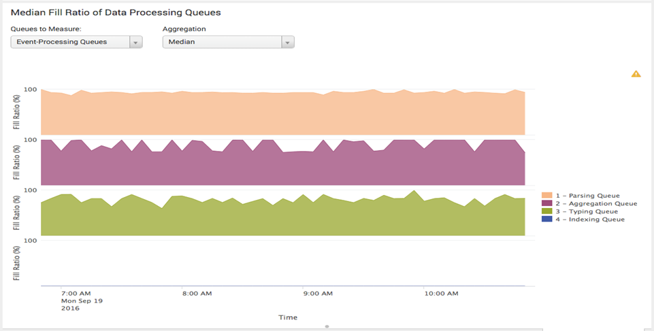
Data ingestion – What can go wrong?
Indexer Data Processing Queues are blocked
Data processing queues are in a pipeline
For example a block in the typing queue (pictured) effects the aggregation queue and all queues above
Notes:
This is an example of problems in the queues during data ingestion. In this picture on the right hand side, the top three queues are close to full, the typing queue, aggregation queue and parsing queue are all blocked.
Since the queues in Splunk within a pipeline, you always want to start troubleshooting from the last blocked queue, in this example the typing queue.
You may encounter this scenario in your Splunk environment and understanding what might cause the issue is important to prevent and resolve the blocking.
This example comes from the monitoring console.

Slide 7
Data ingestion Issues
Aggregation queue blocked, the root cause was merging unusually large events (over 10K lines) using SHOULD_LINEMERGE = true
This issue took down all indexers in the cluster at the same time
Switching to a LINE_BREAKER resolved this issue
Poorly written transforms can also cause blocking in the typing queue
Notes:
A production scenario you may encounter is a blocked aggregation queue, this can block data ingestion within the indexer cluster. In an example all indexers were effected.
The root cause was extremely large multi-line events that were attempting to line merge in memory.
Using the line breaker property resolved this and if you do see a similar issue in your environment you may wish to consider switching to the line breaker.
The line breaker is extremely efficient at merging many lines together, the SHOULD_LINERMERGE may hit issues once you have many lines per event.
2nd scenario of poorly written regular expressions.

Slide 8
Data ingestion - Timestamp Parsing
Multiple timestamps in a single line can confuse Splunk
The _time field may be set in the future or in the past
XML events with whitespace & dates in the file will cause this issue
If the issue occurs the events may be split incorrectly
Manually parsing timestamps (TIME_PREFIX, TIME_FORMAT in props.conf ) improves indexing performance
Notes:
Invalid timestamp parsing is one of the most frustrating events that can happen to you as a Splunk administrator.
Multiple timestamps within 1 line can confuse Splunk time parsing, Splunk will often chooses the second timestamp within the same line.
Another common issue is with multi-line log entries that have a timestamp on a new line, for example a dump of an XML event, this also causes a single log event to break into multiple pieces.

Slide 9
Data ingestion – Timestamp parsing
What issues might occur?
Timestamps parsed with a date in the future
Timestamps parsed with a date in the past
Enable alerting to detect the issue, please refer to the appendix for an example
Notes:
While you will want to try to prevent this issue from ever occurring, it is likely that eventually some data will not get parsed as expected. You should consider creating alerts to find when the problem has occurred..
The application mentioned at the end of this presentation provides example alerts that you can use for detecting this issue.

Slide 10
Indexer Performance/ Configuration Issues
Part 2 - Index sizing

Slide 11
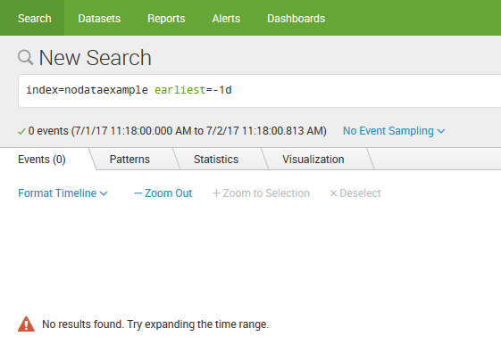
Data ingestion – Index Sizing Issues
Events rolled to frozen bucket too quickly
Notes:
In this picture the data from a production index has been lost the day after it was ingested.

Slide 12
Data ingestion – Index Sizing Issues
Due to not having TIME_PREFIX, TIME_FORMAT configured incoming data had a parsed timestamp of two years in the past
Buckets rolled to frozen contained both recent data and data from what appeared to be “two years ago”
Some of the frozen buckets contained data from only one day ago, Splunk’s reputation was damaged within the company
Recommendation – ensure timestamp parsing is working, avoid reaching the index size limit if possible
Notes:
So why did we lose data after only 1 day?
We had a combination of issues, the first related to our timestamp parsing configuration not working as expected, this resulted in some of the incoming data receiving timestamps 2 years in the past. So if that was today we would be timestamping incoming events as if they were read in 2015.
The second contributor was the index size limit was reached, surprisingly this causes buckets to roll based on the oldest timestamp of the bucket, we will discuss this further on the next slide.
Since this damaged Splunk’s internal reputation in the company, I would recommend you attempt to use manual timestamp parsing where possible and also attempt to avoid reaching the index size limit.

Slide 13
Data ingestion – Index Sizing Issues
By default buckets will roll to frozen when the oldest timestamp of a bucket is past the frozenTimePeriodInSecs (default of 6 years)
When an index reaches the size limit the behaviour is different, buckets will be frozen based on the oldest date of data in the bucket
It does not matter if the bucket contains both new and old data
This can become an issue if your data has timestamp parsing issues
Notes:
Continuing our discussion from the previous slide if the frozenTimePeriodInSecs setting is used the buckets will only roll to frozen once all data is older than the mentioned period, the default is 6 years.
However, if you do rely on the size based limit for the index or volume, the buckets are rolled based on the oldest date of data in the bucket. Therefore a bucket could have both really old, and really new data.
In the example from the previous slide, the 1 day old data was sometimes parsed with a 2 year old timestamp and this resulted in a data loss scenario as the buckets with the old timestamps were frozen first.

Slide 14
Data ingestion – Index Sizing
indexes.conf can be used to limit the size of the hot, cold and overall size per index and per volume
The scenario of a flood of non-prod logging data has caused an index to roll data older than a few days to frozen
The root cause was an infinite loop in the application logging
Without appropriate index sizing and index separation we would have lost production data
Recommend that both the frozenTimePeriodInSecs setting is used in addition to setting a maximum index/volume size
Notes:
You will likely want to use both the frozenTimePeriodInSecs and the index and volume size limits, use the index and volume sizing as an upper safety limit to prevent disk space issues.
The production scenario you encounter is a problematic application in an infinite loop sending very large amounts of logs in Splunk. This has resulted in the index only keeping data for a few days due to the flood of data.
Since we controlled the index size the damage was isolated to a single index.

Slide 15
Data ingestion – Index Configuration
Consider creating subdirectories for sets of Splunk indexes (var/lib/splunk/oper/) for flexibility
For example separating the security specific indexes from operational indexes
When setting volume sizing keep in mind that the data model acceleration files use a different volume (_splunk_summaries) compared to the index hot/cold path
Configure sizing within indexes.conf to handle the loss of an indexer
Notes:
In addition to the previous notes there are a few additional tricks you may wish to consider.
Having a sub-directory separating sets of indexers allows future flexibility in terms of disk setup, or at least the ability to estimate disk usage more easily per sub-section.
An additional tip is that if you do create volumes, keep in mind data model acceleration stays in a separate volume.
Finally, the index and volume sizing will need to cater for when an indexer is down for an extended period.

Slide 16
Indexer Performance/ Configuration Issues
Part 3 - Bucket sizing

Slide 17
Data ingestion – Bucket Tuning
Splunk bucket sizes by default are set to auto (750MB per bucket) they can also use auto_high_volume which is 10GB per bucket on 64bit machines
A rule of thumb is to have a bucket roll per day per indexer (maxDataSize), the dbinspect command is useful to determine the bucket sizing settings
The number of buckets searched impacts search performance
Notes:
Why would you want to tune the bucket settings?
The default of 750MB/bucket may not be appropriate for a high volume index, the auto_high_volume setting can go as high as 10GB per bucket and this may be too high for some specific scenarios.
From a tuning point of view you should attempt to aim for a bucket rolling each day.
Since the number of buckets searched can impact performance there is a happy medium between too many and too few.

Slide 18
Data ingestion – Bucket Tuning
If the hot path is not large enough then…
This can result in the creation of many smaller buckets due to lack of disk space to store the number of hot buckets required (the default settings are 3 hot buckets and 750MB/bucket)
If the timestamp parsing is not working correctly then…
Buckets can roll due to the difference in the timestamps of the incoming data and therefore you may have smaller buckets than expected
Notes:
When tuning buckets, what can go wrong?
If the index hot path is set to a size that is smaller than the maximum bucket size of all the hot buckets on disk, for example if you set the bucket sizing to 1GB and you have the default hot buckets then the hot partition must be larger than 3GB, then the indexer will roll the buckets to cold very quickly, also known as a bucket explosion.
You may see less dramatic version of this if your environment has timestamp parsing issues.

Slide 19
Indexer/ Heavy Forwarder
Miscellaneous Issues

Slide 20
Indexer/Heavy Forwarder
Splunkweb can become unresponsive due to reaching the number of sockets/threads (dynamically configured)
A deployment server handling many incoming clients may require tuning
Watch for high CPU utilisation on Splunk servers
We have alerts setup utilising the NMON for Splunk application
The Splunk introspection data or the Monitoring Console can be used
Notes:
What other issues have we seen on heavy forwarders?
We have hit the limits on the deployment servers Splunkweb settings, the sockets and thread numbers are dynamically configured based on the number of processors on the system, you can override these settings to increase the limit.
You will likely want to alert on high CPU usage on any splunk server, we use the nmon app for Splunk, the monitoring console or introspection data can be used for this same purpose.

Slide 21
Indexer Search Optimisation

Slide 22
Search Optimisation
Batch mode search parallelisation
The default value is 1
Changing the value to 2 will increase historical batch search performance at the cost of thread & memory consumption on the indexers
Notes:
What settings can be tweaked for search optimisation?
Batch mode search parallelisation can be increased, this allows multiple buckets to be read at the same time during a batch mode search, however it does cost thread and memory consumption at the indexer level.

Slide 23
Indexer Cluster Issues
Data distribution within the cluster

Slide 24
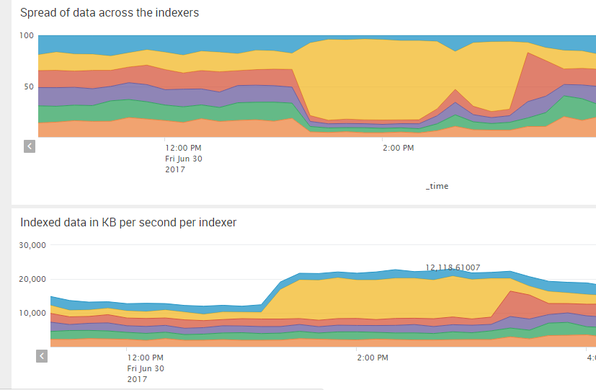
Data Distribution Per Indexer
What can go wrong?
In this example the spread of data over the cluster changes during the day…
Notes:
What can go wrong with data distribution within an indexer cluster?
This picture shows around approximately the 2PM mark that 1 of the indexers is taking the majority of incoming load and therefore has the majority of data, we discuss the implications of this on the next slide.

Slide 25
Data Distribution Per Indexer
An uneven data balance can cause more CPU & I/O usage on some indexers
80% of the network traffic on weekends got sent to 2 indexers in the 5 node indexer cluster
The data model acceleration searches resulted in 100% CPU utilisation on the indexers that received this extra volume of data.
The remaining 3 indexers in the 5 node cluster were relatively quiet (<50% CPU)
Notes:
What problems can the uneven data cause?
You will notice additional CPU and IO usage on the indexers that have more data, this will be further exaggerated if you are using data model acceleration, for example the Splunk CIM application.
In our production system we saw 80% of the network traffic go to 2 nodes on weekends, this resulted in the 2 mentioned indexer nodes reaching 100% CPU usage and therefore all searches in the cluster took longer to complete.

Slide 26
Data Distribution Per Indexer
You should aim for an even data spread within the cluster
autoLBFrequency – attempt to divide data evenly over one or more minutes, for example 20 seconds across 6 indexers
Dropping the setting below 15 seconds can fill up your queues
In 6.5+ the EVENT_BREAKER setting (props.conf ) will split large/rapidly growing files across the indexer cluster
In Splunk 6.6 there is a new feature in outputs.conf that allows load balancing of data by size (autoLBVolume)
Notes:
What can you change to improve data distribution?
Within the forwarders, ensure your autoLB frequency is set to a reasonable number, you can evenly divide the data over a number of minutes, in a 6 node cluster we used 20 seconds. You can go lower than this but there is some risk of additional load on the indexer/forwarder queues
In 6.5 and above Splunk forwarders you can use the event breaker to ensure the forwarder does not read until the end of file.
In 6.6 and above you can now load balance by size instead of time!

Slide 27
Data Distribution Per Indexer
Consider dedicating a universal forwarder for ingesting large files
For files >2GB consider lowering the maxKpbs
This prevents a single indexer getting most of the data
Indexer queues will not be blocked if the ingestion is throttled
Notes:
An additional trick you can use is dedicating a universal forwarder for ingesting large batch log files.
For example if you have 10GB of logs dumped via FTP at a single point in time, if the forwarder attempts to read/forward to the indexers too quickly the indexers queues become blocked.

Slide 28
Data Distribution Per Indexer
Consider increasing parallelIngestionPipelines on heavy forwarders to improve the data distribution
This allows the forwarder to talk to 2 indexers at the same time
Use a tstats query to monitor the data distribution among indexer cluster members
| tstats count where index="*" by splunk_server, _time span=10m | timechart span=10m sum(count) by splunk_server
Notes:
An additional tweak relating to the distribution of data is the parallelIngestionPipelines setting. On heavy forwarders this results in 2 sets of queues and therefore 2 TCP out queues talking to multiple indexers at the same time and this can make the data distribution more even.
In terms of monitoring data distribution within an indexer cluster, a tstats query can be used to roughly measure the amount of data per cluster member, this query is also included in a dashboard at the end of the presentation.

Slide 29
Search Heads
Performance issues relating to user behaviour

Slide 30
Search Head Tuning
The default search time range in pre-6.6 versions of Splunk is “All time”, the ui-prefs.conf can be changed to “Today” to reduce the load on both search heads and indexers
User roles can be limited in terms of search time window, run time, and the number of concurrent searches
Roles can also be used to control the default indexes searched for a particular user role
Notes:
As mentioned on the previous slide in Splunk 6.6 the default time period is no longer all time, however in older versions it is something you need to change in the ui-prefs.conf
You can use the user role settings to control search time windows, run times, concurrent searches.
You may also wish to limit the default indexes searched by a user role, this is the list used when a search does not specify an index, you may want to be careful to not over restrict the users as they may resort to searching all indexes instead.

Slide 31
Search Head Tuning – What to watch for?
Scheduled searches should use specific indexes (do not use index=*)
Limit search time period to prevent all time scheduled searches
Consider configuring Max Historic Search Limits (user role configurations)
Notes:
What issues may you see on search heads?
There are a few common ones we have identified in our environment, you may wish to watch for scheduled searches not be narrowing down to any index, or scheduled searches using index=*
There is a nearly identical problem in dashboards in relation to the index=* setting or not specifying an index.
Another issue is when no time limits are specified or an all time scheduled search is created.
Finally there are also search limits which can be used to improve performance but can also effect end users.

Slide 32
Search Head Tuning
If allowing real time searches, consider indexed realtime mode (Splunk Enterprise Security does this by default)
Note that this particular setting applies to a user only if the setting is readable/exported to the user
Review the max_searches_per_cpu setting in the limits.conf to ensure you are appropriately utilising your indexers/search heads (the default can require tuning)
Notes:
You may be wondering what additional settings are available to improve performance at this level.
The indexed realtime search mode in Splunk will result in a 60 second delay in realtime searches, however it does prevent a realtime search from consuming an entire CPU core and is used by default in some major Splunk applications such as enterprise security. We use this setting in both our non-enterprise security cluster to allow users to continue to use realtime but to prevent them from fully utilising the indexer CPU.
You may wish to trial this in your environment or disable realtime searches to improve indexer performance.
The max searches per CPU setting will allow you to run the maximum number of searches that the indexers can handle and may need tuning up or down depending on your environment.

Slide 33
Data Model Acceleration
Data Model & Report Acceleration can create many CPU/IO intensive searches on the indexers
Avoid using index=* in data models
Acceleration searches run every 5 minutes therefore narrowing down the indexes searched can make a measurable difference in performance
Shortening the data model acceleration period will also reduce both disk usage & CPU/IO on the indexers
If you do tweak the index settings, consider regular checks to see if any new indexes contain data relevant to the data model
Notes:
You will need to watch data model and report acceleration, they can quickly cripple even a powerful indexer cluster.
There are two main criteria you can use to reduce the impact on the indexers of an accelerated data model, they are tweaking the index= criteria within the data model and reducing the duration of the accelerated data.
As an additional tip when we narrow down data models to a particular index, and then run a daily check to ensure that no indexes have started including data that should be in a specific data model.

Slide 34
Search Heads
Issues that will effect users
Notes:
This section is about assisting users who are new to Splunk through finding errors that will hinder their Splunk experience.

Slide 35
Detecting potential issues for users
Scheduled searches that have become orphaned
When the owner of a report/alert gets deleted, the report/alert will stop running
Consider opening permissions on private alerts (shared link)
Scheduled searches not running due to a syntax error
Notes:
What can go wrong on the search heads?
Orphaned scheduled searches can happen when the author / owner of the scheduled search leaves the company, this stops the search running.
Scheduled searches can have a private level of access, if this alert then sends a results link via email it will only be accessible to the author of the alert.
You may also have scheduled searches which are failing to run due to syntax errors and the owner of the search may be completely unaware.
If you have alerts to watch for these scenarios you can advise the effected users before they contact you about the issue.

Slide 36
Things to watch for
Splunk scheduler skipping searches (or excessive scheduling delays)
Splunk users violating the search quota
The user may not be aware of the messages appearing in Splunk
Splunk users violating the disk quota
The user may be confused as to why their searches are no longer working
Notes:
What other potential issues exist on the search head cluster?
You can check if the splunk scheduler is skipping searches or if there are excessive scheduling delays, this can be done through the internal indexes or the monitoring console.
Check for anyone violating the search quota, the individual may not be aware of this issue.
You may also want to watch for disk quota issues, we have had someone advise that Splunk is not working anymore when they have reached their disk quota and not noticed the messages in the top right hand side of the GUI…

Slide 37
Universal Forwarders
Performance issues

Slide 38
Universal Forwarders
Performance/CPU usage issues
Splunk universal forwarders generally use more CPU when configured to monitor directories or file names with wildcards
Recommend using the complete filenames and avoiding wildcards
In our testing we have found 2-3% CPU is normal for monitoring exact file names, while 20-30% CPU is not unusual for monitoring multiple directories with a lot of files getting created/deleted

Slide 39
Universal Forwarders
Troubleshooting the forwarder
Learn how to use the btool command for troubleshooting
For example - splunk btool inputs list --debug
Use the REST API endpoints to troubleshoot inputs/outputs
URL https://localhost:8089/services/admin/inputstatus/TailingProcessor:FileStatus
Or use the CLI command - splunk list inputstatus
Notes:
There are a few ways to troubleshoot the forwarder.
splunk btool can be used to list the current configuration, this tool merges all configuration of a particular type into 1 output so you can determine what settings have been applied and where they have been applied from.
The second tip relates to checking the status of the tailing processor, this can show you where in the file the Splunk forwarder has reached.
Both of these are in addition to the splunkd.log file which provides some troubleshooting information such as the stanzas read and the file that are been watched.

Slide 40
Universal Forwarders
Troubleshooting the forwarder
Impact of using ignoreOlderThan setting in the inputs.conf file, files are ignored until the next restart
Use this setting with great caution
Watch the OS ulimit on all forwarders, 8192 file descriptors is a reasonable limit on most Linux/AIX forwarders
Having the ulimit set too low can result in the forwarder crashing
Notes:
You may wish to consider avoiding the ignoreOlderThan setting in the inputs.conf. The setting is designed so that the forwarder will ignore a particular file once a number of days has been reached, the problem with this setting is that once the file is ignored it is never read again.
For example if you set ignoreOlderThan to 2 days and your webservers access.log stops updating for 2 days, that file will never be read again even if the log file get updated with new data. The forwarder will only read the file again once restarted.
In general I recommend avoiding this setting.
The default ulimit settings on some operating systems can result in the forwarder crashing, so therefore ensuring the ulimit is appropriately set is always a good idea.

Slide 41
Universal Forwarders
What to watch for
Watch for excessive checkCRC errors, this can cause files to either not be read, or files to be re-read resulting in a duplication of data
The inputs.conf setting of initCrcLength may need tweaking if the start of the monitored file has a lot of repetitive data (e.g. IBM WebSphere SystemOut)
crcSalt <SOURCE> may be appropriate in some scenarios
Notes:
You will want to check for excessive checkCRC errors occurring in a short period of time.
This can cause data to be duplicated in an index, or a file to be ignored.
Either initCrcLength or the crcSalt <SOURCE> may be able to fix this issue, the splunkd log file will usually provide hints as to when this scenario has occurred.

Slide 42
Wrap Up
Notes:
Congratulations for making it this far! We now have a quick summary of what was discussed.

Slide 43
Wrap Up
Manually configure timestamp parsing (for both performance and correct timestamping)
Appropriately size indexes, buckets and volumes
Aim for even data balancing across all indexers within a cluster
Part 1
Notes:
We have discussed many potential issues so far, the most important is manually configuring timestamping within the props.conf This setting will prevent many of the other issues mentioned in this presentation.
Appropriate sizing of indexes and volumes will limit the damage from any flood of data.
Ensuring an even data balance within the cluster will help prevent CPU /IO issues on a single member, and this is important if any of the cluster members are close to the CPU , IO or filesystem limits.

Slide 44
Wrap Up
Tune data model acceleration
Alert on poorly configured scheduled searches and dashboards
Alert on user level issues
Part 2
Notes:
Data models that are accelerated will need some tweaking or they may cause performance issues for the indexers
Poorly configured scheduled searches and dashboards can also cause performance issues.
Finally user level issues won’t cause a performance issue but will confuse those who use Splunk so letting them know of the issue before they get in contact is a nice thing to do.

Slide 45
The Splunk Admins application
Why would I want to download this?
All dashboards and alerts mentioned in this presentation can be found at:
http://github.com/gjanders/SplunkAdmins

Slide 46
Thanks & QA
Notes:
Thankyou for your time, feedback is welcome on this presentation or if you have any tips around growing your Splunk environment!
At this stage do we have any questions?

Slide 47
Appendix

Slide 48

OS Level Tuning

Slide 49
OS Tuning
Linux Only
What are the most important settings to watch?
transparent huge pages
Should always be disabled on Splunk enterprise servers, this is optional for forwarders
ulimits
Should be appropriately set within the limits.conf of the OS & this may be required within the init.d file as well, note that 8192 file descriptors is not enough for a busy indexer
The nproc setting (number of processes per user) becomes an issue in Redhat Linux (the default is 1024)

Slide 50
OS Tuning
Linux Only
The tuned application
Adjusts various OS settings for your chosen tuning level, such as the swapiness level
The IO Scheduler
Always choose the appropriate scheduler for your hardware
noop is likely the best fit for VMWare guests
deadline often works better with bare metal
Performance test Splunk if possible

Slide 51

Capacity Planning for Splunk

Slide 52
Capacity planning for Splunk
General Tips
Bare metal hardware with locally attached storage is the fastest performance we have obtained for the indexing tier
If using VMWare hardware do not share CPU/memory (or ideally storage)
CPU ready and co-stop times need to remain low on VMWare for Splunk to perform well
Cluster masters and deployers are good candidates for virtualisation, indexers are not
Search heads can become a bottleneck if they have underlying storage or CPU issues

Slide 53
Capacity planning for Splunk
General Tips
A Splunk environment utilising data model acceleration without fast I/O performance will reach full CPU utilisation quickly!
100GB/day in our case on VMWare 32 VCPU/16 core machines
Splunk indexer clusters can scale with faster I/O and more CPU (vertically) or with more indexers (horizontally)
Refer to the Splunk capacity planning documentation for detailed information

Slide 54
Appendix
What does the application include?
All mentioned alerts exist within the application available on https://github.com/gjanders/SplunkAdmins
The application covers a large number of potential scenarios that can cause issues within a Splunk environment, the alerts are grouped into categories:
Issues that exist at the search head level only
Issues that exist at the indexer level only
Issues that exist at the forwarder level
Issues that may exist in any Splunk enterprise or non-enterprise instance
Issues specific to the deployment server

Slide 55
Appendix
What does the application include?
The application also includes a few dashboards
Dashboard - Troubleshooting indexer CPU
This complex dashboard has multiple views of which searches are utilising the indexer CPU time and memory
Dashboard - Indexer data spread
An attempt to visualise the distribution of incoming data and searchable data within an indexer cluster
Dashboard - Scheduled Searches Distribution
A simple visualisation of the searches running per search head

